Slide 1
Self-supervised Video Representation Learning
PhD Thesis Defense
Jiangliu WANG
Supervised by Prof. Yun-hui LIU
September 2020
Notes:
Good afternoon, everyone
welcome to my thesis defense, today I am going to talk about “self-supervised video representation learning”

Slide 2
Content
Introduction
Background
Related work
Our contributions
Methodology
Part I: Spatio-temporal statistics regression for self-supervised video representation learning
Part II: In-depth investigation of spatio-temporal statistics
Part III: Play pace variation and prediction self-supervised video representation learning
Conclusions
Notes:
This is the content of this thesis defense
….
And finally, I will summarize the works and provide some future directions

Slide 3

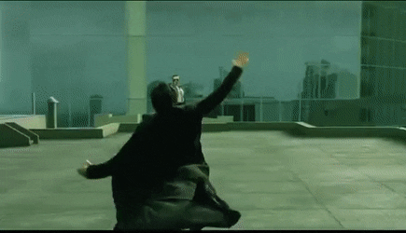
Video understanding
Introduction
Methodology
Conclusions
Background
Related work
Our contributions
10-seconds HD video
Human visual system
[The Matrix]
155, 000,000 elements
100,000,000,000 Neurons [1]
“A man is dodging a bullet”
[1] Suzana Herculano-Houzel. The human brain in numbers: a linearly scaled-up primate brain. Frontiers in human neuroscience, 3:31, 2009.
Notes:
100 billions neurons

Slide 4


Can a computer understand this video?
Introduction
Methodology
Conclusions
Background
Related work
Our contributions
10-seconds HD video
Computer
A non-trivial task for a computer
Notes:
But what if we input this video sample into a computer, can a computer understand the video content, just like human?
This is not a trivial task for a computer, especially considering the high dimensional input data and limited computational resources.

Slide 5
Introduction
Methodology
Conclusions
Background
Related work
Our contributions
Video representation
Original video
Computer
…
Compact and abstract representations without
affecting the video content understanding
Notes:
To solve this problem, researchers propose to first compress the original video data into a compact video representation,
And then input the vide representation into the computer.

Slide 6
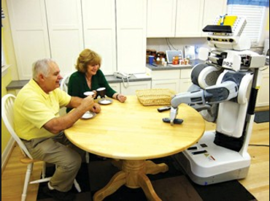
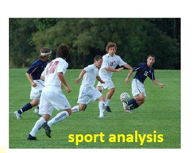
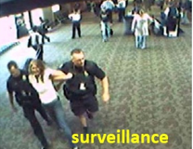
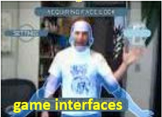

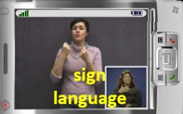
Applications
Introduction
Methodology
Conclusions
Background
Related work
Our contributions
elderly caring
Notes:
It has a wide range of applications
So how can we obtain good video representations?

Slide 7
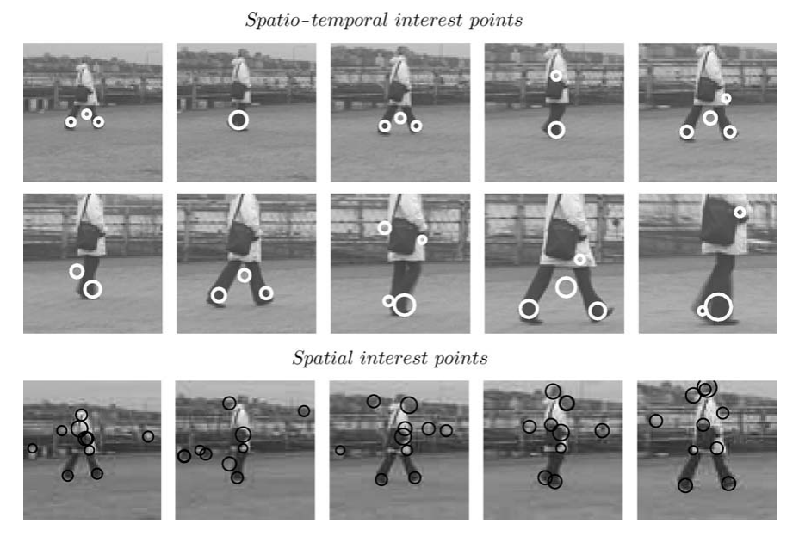
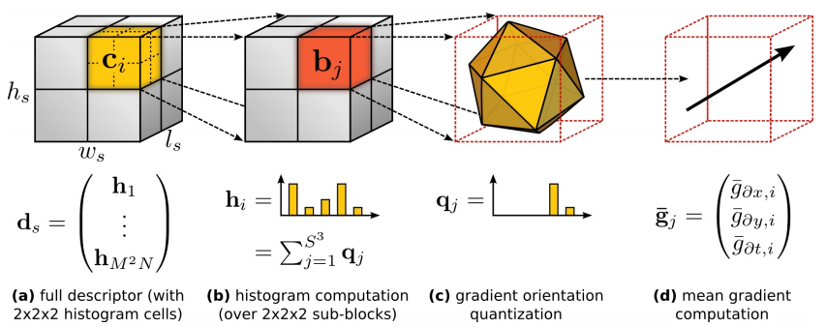

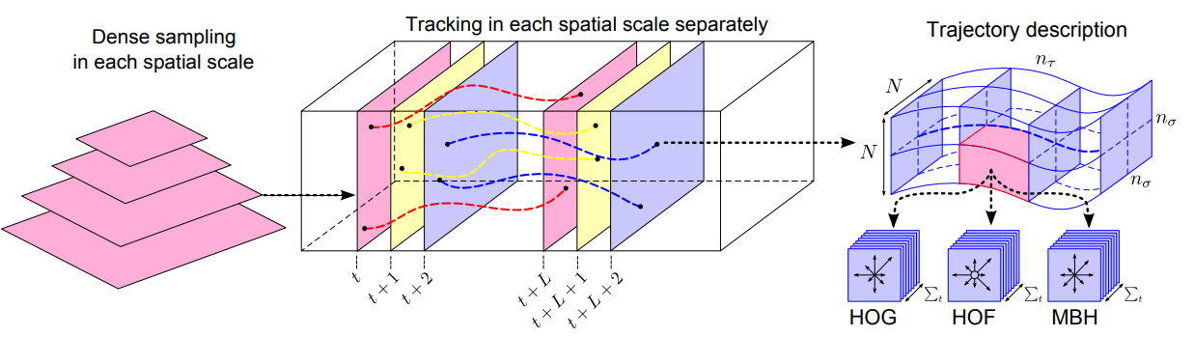
Handcrafted video representation (features)
Introduction
Methodology
Conclusions
Background
Related work
Our contributions
Supervised video representation learning
Self-supervised image representation learning
Self-supervised video representation learning
Elaborately designed by researchers
[STIP. Laptev et al. ICCV 2003]
[HOG3D. Klaser et al. BMVC 2008]
Simple and controlled setting
Fail to cope with variations of view, appearance, light, etc., in the real-world
[Dense trajectories. Wang et al. CVPR 2011]

Slide 8
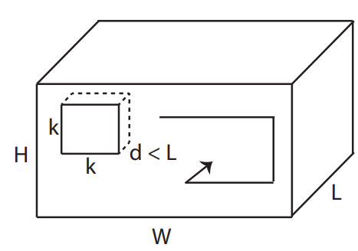
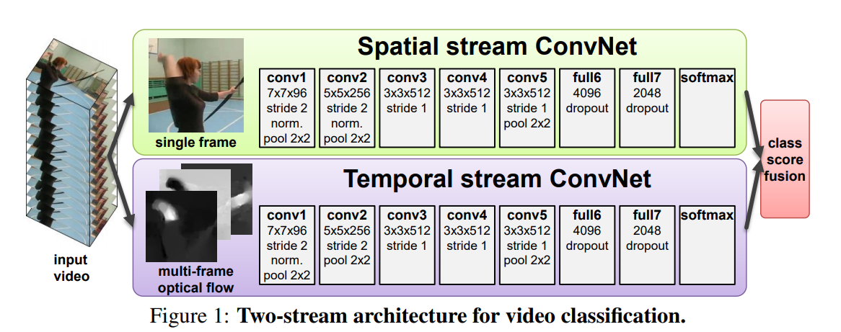
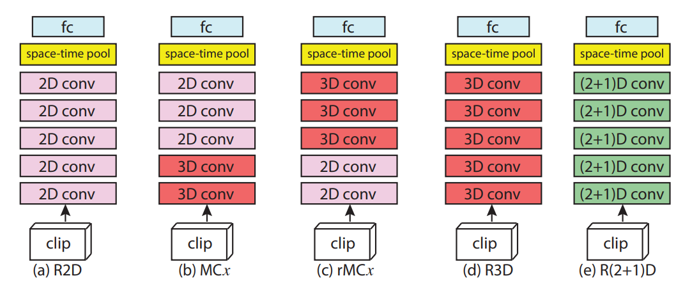
Handcrafted video representation (features)
Introduction
Methodology
Conclusions
Background
Related work
Our contributions
Supervised video representation learning
Self-supervised image representation learning
Self-supervised video representation learning
Ingenious neural network architectures
RGB: C3D, R(2+1)D, S3D, etc.
RGB + optical flow: two stream, I3D, etc.
Large mount of human-annotated video data
Substantial computational resources, i.e., GPU
[C3D. Tran et al. ICCV 2015]
[Two-stream. Simonyan et al. NeurIPS 2014]
[R(2+1)D. Tran et al. CVPR 2018]
Notes:
To overcome drawbacks of handcrafted features….
Researchers have been developed a wide range of …
It can be divided into two categories based on the input video data…
Besides the neural networks,

Slide 9
Handcrafted video representation (features)
Introduction
Methodology
Conclusions
Background
Related work
Our contributions
Supervised video representation learning
Self-supervised image representation learning
Self-supervised video representation learning
Heavy dependence on labeled video data, expensive and time-consuming
[C3D. Tran et al. ICCV 2015]
[Two-stream. Simonyan et al. NeurIPS 2014]
Fail to utilize large amount of unlabeled video data
- Users in YouTube upload more than 500 hours videos every single minute[1]
[R(2+1)D. Tran et al. CVPR 2018]
[1] https://www.tubefilter.com/2019/05/07/number-hours-video-uploaded-toyoutube-per-minute/.

Slide 10
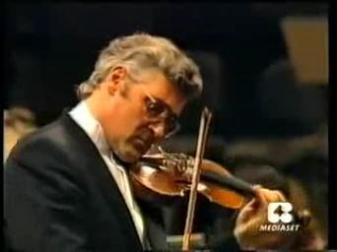
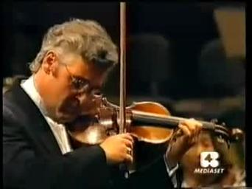
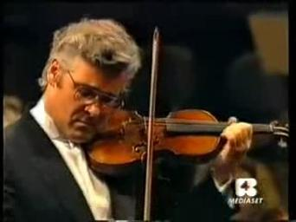
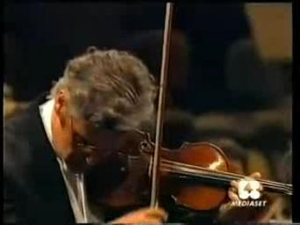
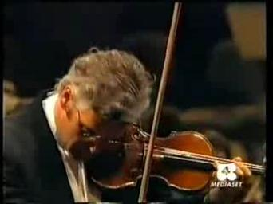
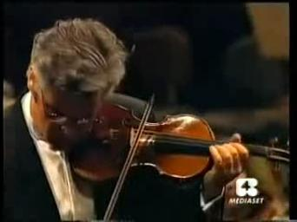
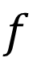

Handcrafted video representation (features)
Introduction
Methodology
Conclusions
Background
Related work
Our contributions
Supervised video representation learning
Self-supervised
learning
Self-supervised video representation learning
Supervised Learning
$$f$$
Action class: Playing Violin
$$f$$
h
Self-supervised Learning
Predict future frames
pretext task
Notes:
To solve this problem, here comes the self-supervised learning…
The goal of self….
To valuate the pretext task is good or not…

Slide 11
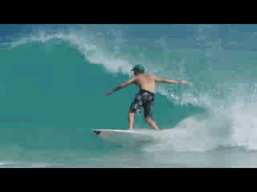
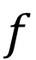
Handcrafted video representation (features)
Introduction
Methodology
Conclusions
Background
Related work
Our contributions
Supervised video representation learning
Self-supervised
learning evaluation
Self-supervised video representation learning
$$f$$
$$f$$
h
Self-supervised Learning
Predict future frames
Videos
Classification: Surfing
Notes:
Finetune

Slide 12

Handcrafted video representation (features)
Introduction
Methodology
Conclusions
Background
Related work
Our contributions
Supervised video representation learning
Self-supervised
learning evaluation
Self-supervised video representation learning
$$f$$
$$f$$
h
Self-supervised Learning
Predict future frames
Videos
$$f$$
Classification: Surfing
finetune
Evaluation: Downstream task
Notes:
Evaluation method is termed as downstream task

Slide 13
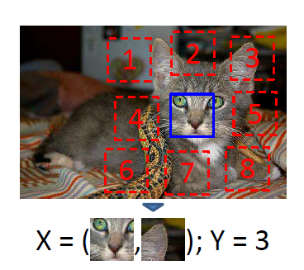
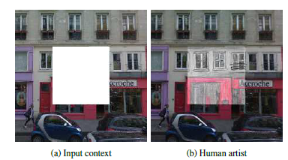
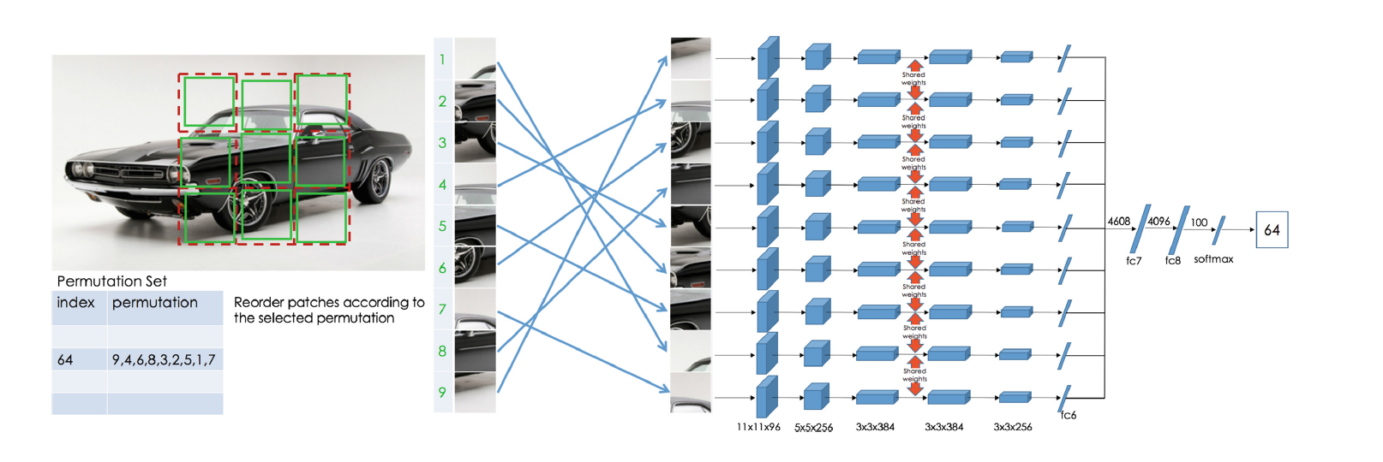
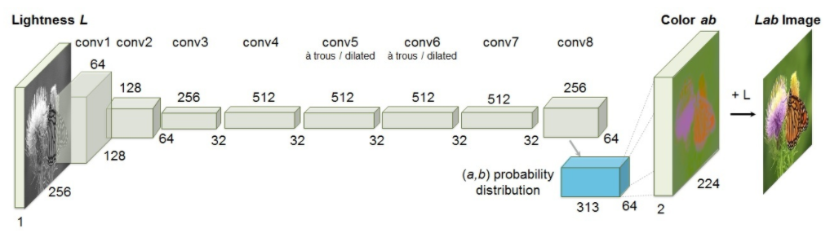
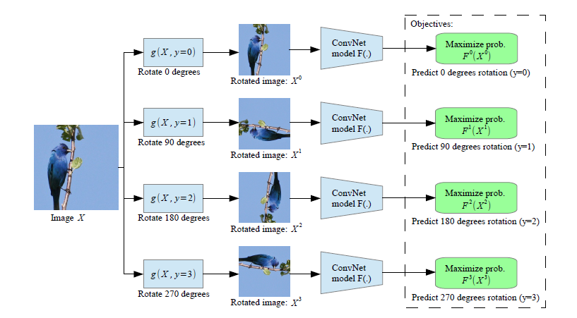
Handcrafted video representation (features)
Introduction
Methodology
Conclusions
Background
Related work
Our contributions
Supervised video representation learning
Self-supervised image representation learning
Self-supervised video representation learning
[Context. Doersch et al. ICCV 2015]
[Inpainting. Pathak et al. CVPR 2016]
[Jigsaw puzzles. Noroozi et al. ECCV 2016]
[Colorization. Zhang et al. ECCV 2016]
[Rotation. Gidaris et al. ICLR 2018]

Slide 14
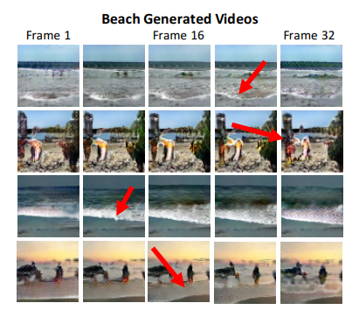
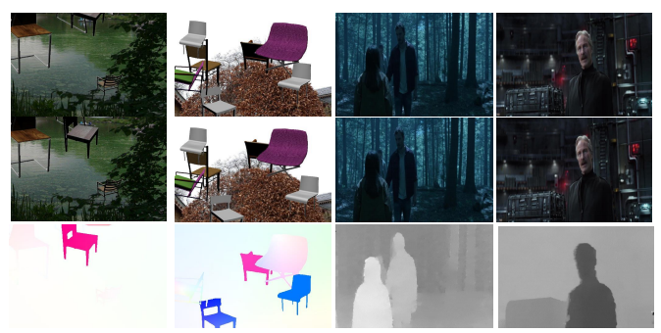

Handcrafted video representation (features)
Introduction
Methodology
Conclusions
Background
Related work
Our contributions
Supervised video representation learning
Self-supervised image representation learning
Self-supervised video representation learning
Generative
Videos
$$f$$
h
Videos
/ optical flows
[Vondrick et al. NeurIPS 2016]
[Gan et al. CVPR 2018]
Notes:
When comes to self-supervised video ..
There are mainly two kind of works

Slide 15
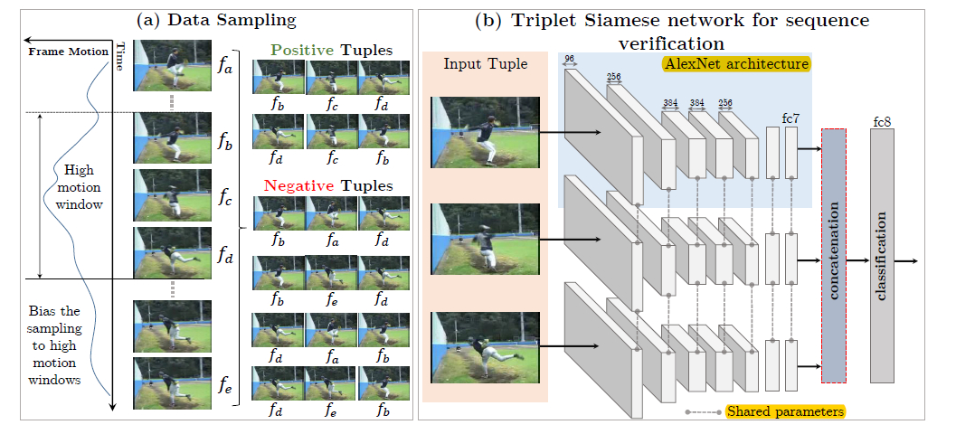
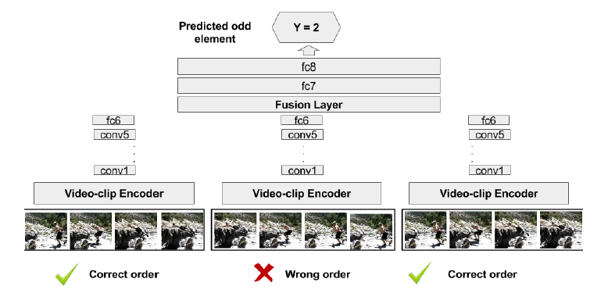
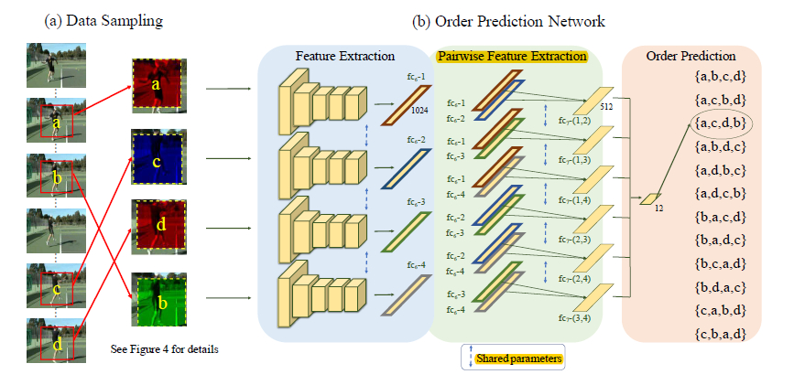
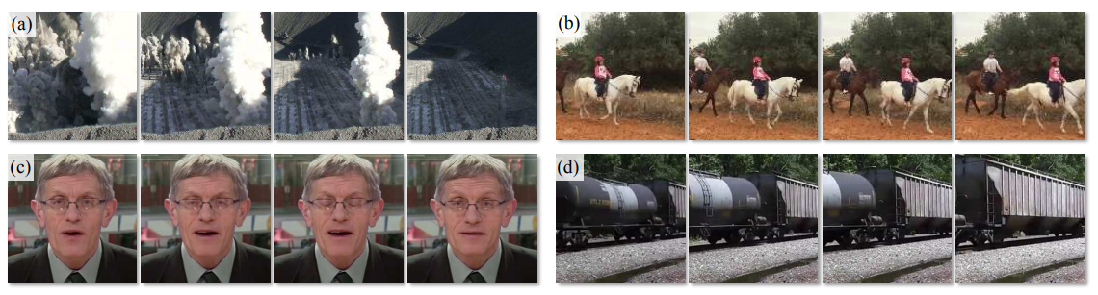
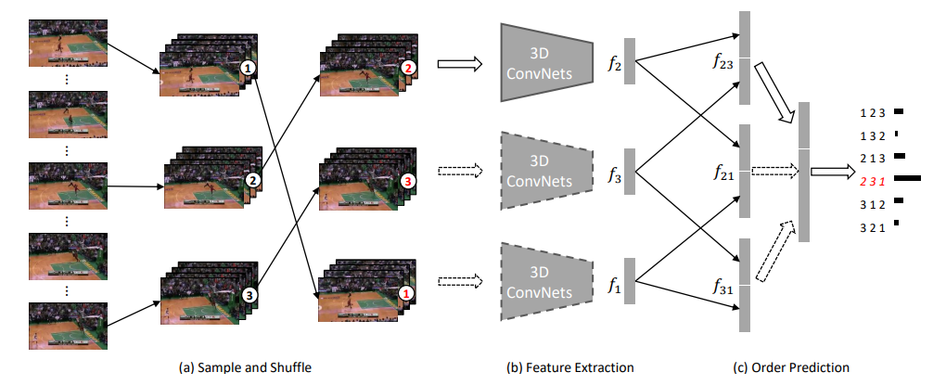

Handcrafted video representation (features)
Introduction
Methodology
Conclusions
Background
Related work
Our contributions
Supervised video representation learning
Self-supervised image representation learning
Self-supervised video representation learning
Discriminative
Videos
$$f$$
Video order verification/prediction
[Misra et al. ECCV 2016]
[Fernando et al. CVPR 2017]
[Lee et al. ICCV 2017]
[Wei et al. CVPR 2018]
[Xu et al. CVPR 2019]

Slide 16
Limitations of current approaches
Introduction
Methodology
Conclusions
Background
Related work
Our contributions
Generative approaches: waste model capacity
Videos
$$f$$
h
Videos
Requiring to predict every pixel in each frame
Notes:
Noise 太大了

Slide 17
Limitations of current approaches
Introduction
Methodology
Conclusions
Background
Related work
Our contributions
Discriminative approaches: focus on (stuck in) video order
Videos
$$f$$
Video order verification/prediction
Any other new pretext tasks characterizing videos?
Notes:
Easy to spot but not easy to solve

Slide 18

Our contributions
Introduction
Methodology
Conclusions
Background
Related work
Our contributions
We propose a novel pretext task --- spatio-temporal statistics regression (Using optical flow)
We further propose a novel pretext task -- video pace prediction (Without using optical flow)
We achieve the state-of-the-art performances, for the first time outperforming supervised pre-training, by systematically investigating the architecture of backbone networks, the scale of pre-training dataset, and the learning strategies.

Slide 19
Introduction
Methodology
Conclusions
Background
Related work
Our contributions
Part I: Spatio-temporal statistics regression for self-supervised video representation learning
Part II: In-depth investigation of spatio-temporal statistics
Part III: Play pace variation and prediction self-supervised video representation learning

Slide 20
Part I: Spatio-temporal statistics regression for self-supervised video representation learning
Introduction
Methodology
Part I
Part II
Part III
Conclusions
Notes:
In part I, we propose a new pretext task…..

Slide 21
Motivation
Introduction
Conclusions
Methodology
Part I: Method
Part I: Experiments
Part I: Discussions
Part II
Part III
“A man is dodging a bullet” [action class]
“He is moving in the center of the video”
“The background is in a green tone”

Slide 22
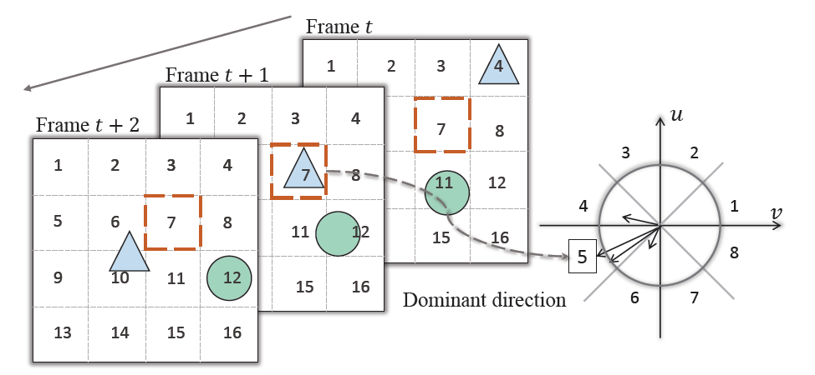
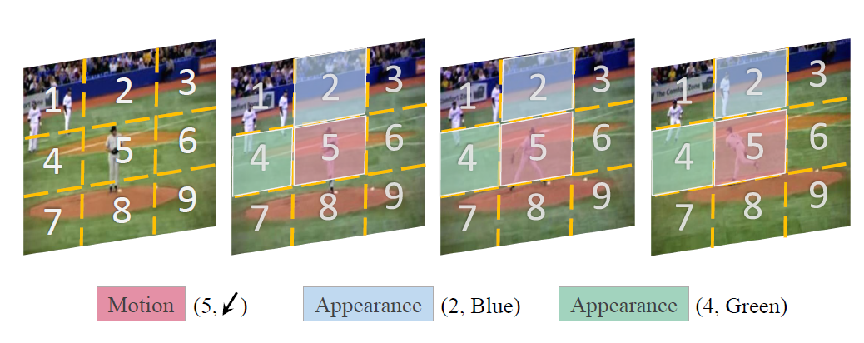
Statistical Concepts
Introduction
Conclusions
Methodology
Part I: Method
Part I: Experiments
Part I: Discussions
Part II
Part III
Motion statistics
- Where is the largest motion?
- What is the dominant direction?
Appearance statistics
- Where is the largest color diversity?
- Where is the smallest color diversity?
- What is the dominant color?
Notes:
Inspired by the human visual system,
We break the video understanding process into several statistical concepts and ask the neural network to answer these questions

Slide 23
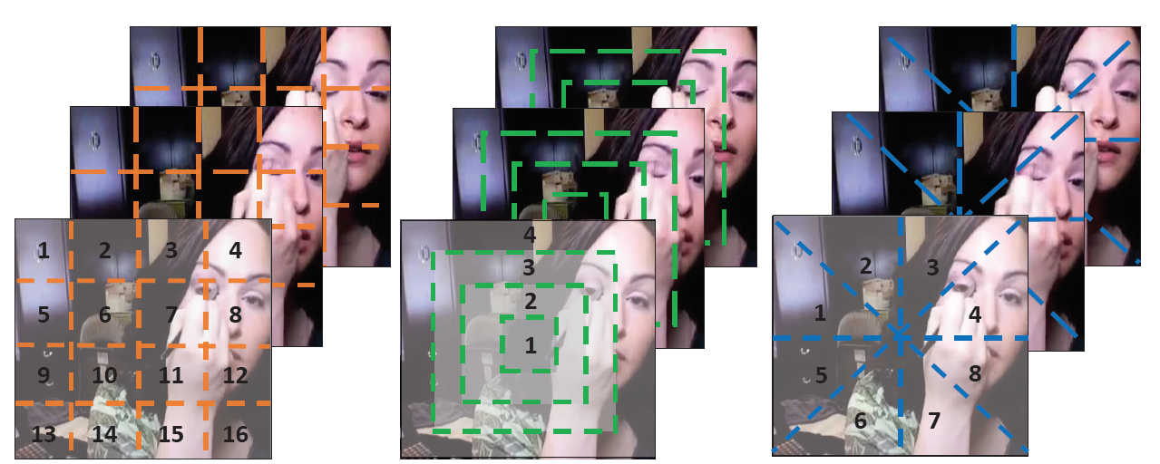

Three partitioning patterns
Introduction
Conclusions
Methodology
Part I: Method
Part I: Experiments
Part I: Discussions
Part II
Part III
How to quantify location?
“Where”?
Number

Slide 24
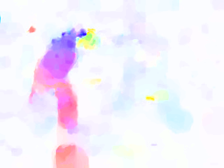
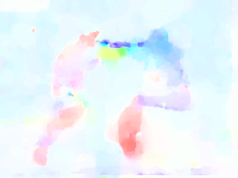
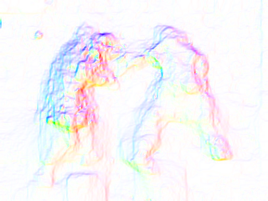
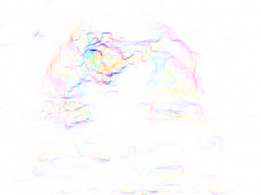

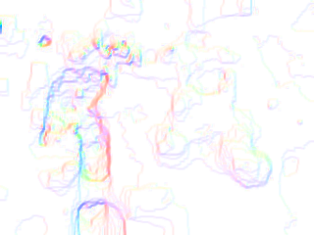

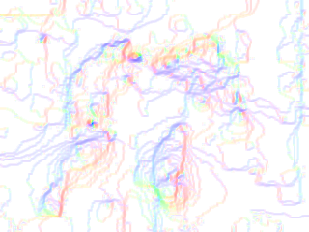
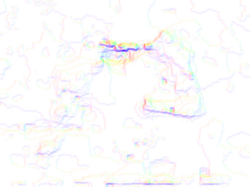
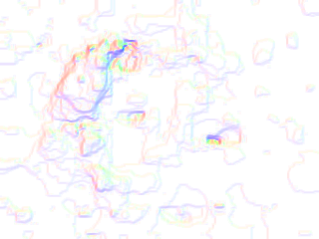

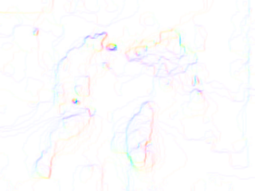
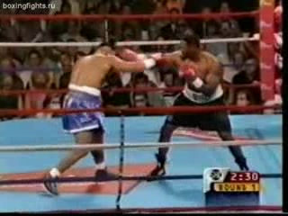
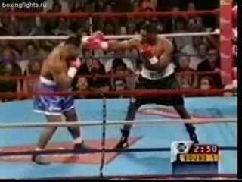
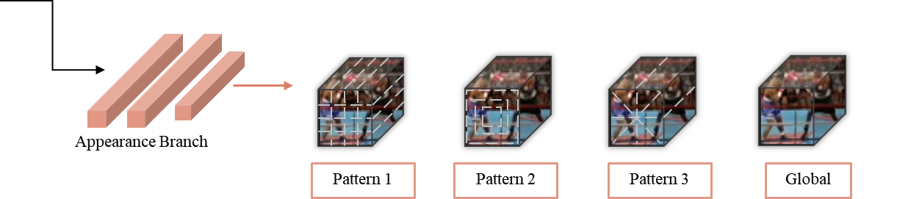
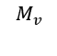
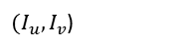





Spatio-temporal statistics: Motion
Introduction
Conclusions
Methodology
Part I: Method
Part I: Experiments
Part I: Discussions
Part II
Part III
Optical Flow
Motion Boundaries
Summarized Motion Boundaries
Pattern
$(p_{u}, o_{u}, p_{v}, o_{v}$)
Global
$(I_{u}, I_{v}$)
$$M_{u}$$
$$M_{v}$$
$(u,v$)
$(u_{x},u_{y}$)
$(v_{x},v_{y}$)
Motion Branch
Pattern 1
Pattern 2
Pattern 3
Global
Input Video Clip
Backbone network
How to quantify largest motion and dominant direction?
Notes:
Legend 放在旁边

Slide 25







Motion boundary
Introduction
Conclusions
Methodology
Part I: Method
Part I: Experiments
Part I: Discussions
Part II
Part III
Motion boundary[1], derivative of optical flow.
Motion boundary sum. Cast $M_{u}, M_{v}$ to Polar coordinates, obtain magnitude and orientation
$$(u, v)$$
$$m_{u}$$
$$m_{v}$$
$$M_{u}$$
$$M_{v}$$
Optical flow
Motion boundary
Motion boundary sum
[1] N. Dalal, B. Triggs, and C. Schmid. Human detection using oriented histograms of flow and appearance. In ECCV, 2006.

Slide 26






Motion statistical labels
Introduction
Conclusions
Methodology
Part I: Method
Part I: Experiments
Part I: Discussions
Part II
Part III
Cast $M_{u}, M_{v}$ to Polar coordinates, obtain magnitude and orientation
For each (local) pattern: 4 motion labels
Largest motion locations: , w.r.t
Dominant motion directions:
$$p_{u}, { p}_{v}$$
$$M_{u}, { M}_{v}$$
$$o_{u}, { o}_{v}$$
3
2
4
1
5
8
6
7
Global motion statistics
Frame index with largest motion: , w.r.t
$$I_{u}, { I}_{v}$$
$$m_{u}, { m}_{v}$$

Slide 27



Spatio-temporal statistics: Appearance
Introduction
Conclusions
Methodology
Part I: Method
Part I: Experiments
Part I: Discussions
Part II
Part III
Pattern
$(p_{l}, { c}_{l}, { p}_{s}, { c}_{s}$)
Global
$(C$)
Input Video Clip
Backbone network
Appearance Branch
Pattern 1
Pattern 2
Pattern 3
Global
How to quantify color diversity and dominant color?

Slide 28




Spatio-temporal color diversity
Introduction
Conclusions
Methodology
Part I: Method
Part I: Experiments
Part I: Discussions
Part II
Part III
Compute the 3D distribution $V_{i}$ in 3D color space of each frame
Use the Intersection over Union (IoU) along temporal axis to quantify the spatio-temporal color diversity:
- Largest color diversity: smallest $IoU_{score}$
- Smallest color diversity: largest $IoU_{score}$

Slide 29





Appearance statistical labels
Introduction
Conclusions
Methodology
Part I: Method
Part I: Experiments
Part I: Discussions
Part II
Part III
For each (local) pattern: 4 labels
Largest/smallest color diversity location:
Corresponding dominant color labels:
$$p_{l}, { p}_{s}$$
$$c_{l}, { c}_{s}$$
Global color statistics
- Dominant color of whole video clip:
$$C$$

Slide 30









Learning with spatio-temporal CNN
Introduction
Conclusions
Methodology
Part I: Method
Part I: Experiments
Part I: Discussions
Part II
Part III
Optical Flow
Motion Boundaries
Summarized Motion Boundaries
Pattern
$(p_{u}, o_{u}, p_{v}, o_{v}$)
Global
$(I_{u}, I_{v}$)
Pattern
$(p_{l}, { c}_{l}, { p}_{s}, { c}_{s}$)
Global
$(C$)
$$M_{u}$$
$$M_{v}$$
$(u,v$)
$(u_{x},u_{y}$)
$(v_{x},v_{y}$)
Motion Branch
Pattern 1
Pattern 2
Pattern 3
Global
Input Video Clip
Backbone network
Appearance Branch
Pattern 1
Pattern 2
Pattern 3
Global
C3D[1]
[1] Du Tran et al. Learning Spatiotemporal Features with 3D Convolutional Networks. In ICCV, 2015.

Slide 31
Implementation details
Introduction
Conclusions
Methodology
Part I: Method
Part I: Experiments
Part I: Discussions
Part II
Part III
Backbone network: C3D, five convolutional layers
Pre-training dataset: UCF101
Baseline: random initialization
Downstream task
Transfer learning, action recognition, UCF101 and HMDB51 dataset
Feature learning, dynamic scene recognition, YUPENN dataset
Videos
$$f$$
Pretext task
Transfer learning
Feature learning

Slide 32
Ablation study
Introduction
Conclusions
Methodology
Part I: Method
Part I: Experiments
Part I: Discussions
Part II
Part III
Self-supervised
Self-supervised
Motion Pattern
Local vs Global
Notes:
Illustrate random

Slide 33
Ablation study: motion vs. appearance
Introduction
Conclusions
Methodology
Part I: Method
Part I: Experiments
Part I: Discussions
Part II
Part III
baseline
baseline
UCF101
HMDB51

Slide 34


Transfer learning: action recognition
Introduction
Conclusions
Methodology
Part I: Method
Part I: Experiments
Part I: Discussions
Part II
Part III
Achieve state-of-the-art results on both datasets (at that time)
Visualization of attention map
Notes:
It will be outperformed in the later PPT
UCF101 dataset
为什么HMDB51这么低，因为很难

Slide 35

Feature learning: dynamic scene recognition
Introduction
Conclusions
Methodology
Part I: Method
Part I: Experiments
Part I: Discussions
Part II
Part III
YUPENN dataset: 420 videos, 14 classes
Pre-trained model, feature extractor
Linear SVM for classification
Achieve state-of-the-art results (at that time)

Slide 36
Discussion
Introduction
Conclusions
Methodology
Part I: Method
Part I: Experiments
Part I: Discussions
Part II
Part III
Novel, spatio-temporal statistics regression
Effective, achieved the state-of-the-art results on two downstream tasks and three datasets
Wide applications, using a classic C3D for self-supervised video representation learning to capture spatio-temporal features
Used UCF101 as pre-training dataset, which is relatively small (~10k videos)
The performance is promising but unsatisfactory (far behind supervised)

Slide 37
Part II: In-depth investigation of spatio-temporal statistics
Introduction
Methodology
Part I
Part II
Part III
Conclusions

Slide 38
Motivation
Introduction
Methodology
Part I
Part II: Method
Part II: Experiments
Part II: Discussions
Part III
Conclusions
To leverage large amount of unlabeled video
Used UCF101 as pre-training dataset, which is relatively small (~10k videos)
To use a much larger pre-training dataset, kinetics-400 (~200k videos)
The performance is promising but unsatisfactory (far behind supervised)
To introduce effective learning strategies
To investigate modern backbone networks

Slide 39

Curriculum learning
Introduction
Methodology
Part I
Part II: Method
Part II: Experiments
Part II: Discussions
Part III
Conclusions
“Curriculum learning”, Yoshua Bengio et al. ICML 2009
Motivation: start out with only easy examples of a task and then gradually increase the task difficulty
Spatio-temporal
Statistics regression
$$f$$
Unordered training samples
Notes:
Basic idea of curriculum learning
Motivation: 讲的不明白，不明确

Slide 40
Curriculum learning
Introduction
Methodology
Part I
Part II: Method
Part II: Experiments
Part II: Discussions
Part III
Conclusions
“Curriculum learning”, Yoshua Bengio et al. ICML 2009
Motivation: start out with only easy examples of a task and then gradually increase the task difficulty
Hard
Easy
Spatio-temporal
Statistics regression
$$f$$
Ordered training samples
Problem I: how to quantify the difficulty of each training sample?
Problem II: how to feed the networks with the sorted training samples?
Notes:
Basic idea of curriculum learning

Slide 41


Scoring function
Introduction
Methodology
Part I
Part II: Method
Part II: Experiments
Part II: Discussions
Part III
Conclusions
Problem I: how to quantify the difficulty of each training sample?
Ratio between magnitude sum of largest motion block and the entire video
Simple/hard sample: large/small ratio
Largest motion block
large magnitude in one direction can already define large motion
Notes:
单独写difficult 和simple分别是哪些

Slide 42

Pacing function
Introduction
Methodology
Part I
Part II: Method
Part II: Experiments
Part II: Discussions
Part III
Conclusions
Problem II: how to feed the networks with the sorted training samples?
- Three pacing functions [1], comparable results.
Fraction of sorted data S
1.0
Step_length
0.5
Single step
Fixed exponential pacing
epochs
Varied exponential pacing
0.0
0
15
30
[1] G. Hacohen, and D. Weinshall. On The Power of Curriculum Learning in Training Deep Networks. In ICML, 2019.
Notes:
Single step 这个可以做成动画的形式， 像Richard 张一样

Slide 43

Modern 3D CNN
Introduction
Methodology
Part I
Part II: Method
Part II: Experiments
Part II: Discussions
Part III
Conclusions
- C3D [1], 3D-ResNet [2], R(2+1)D [2]
T x D x D
1 x D x D
D x D
D x D
T x D x D
T x 1 x 1
(a) 2D conv
(b) C3D
(c) 3D-ResNet
(d) R(2+1)D
[1] Du Tran et al. Learning Spatiotemporal Features with 3D Convolutional Networks. In ICCV, 2015.
[2] Du Tran et al. A Closer Look at Spatiotemporal Convolutions for Action Recognition. In CVPR,2018.

Slide 44
Implementation details
Introduction
Methodology
Part I
Part II: Method
Part II: Experiments
Part II: Discussions
Part III
Conclusions
Pre-training dataset: UCF101(~10k) Kinetics-400(~240k)
Downstream task
Transfer learning, action recognition, UCF101 and HMDB51 dataset
Feature learning
Feature + SVM classifier, dynamic scene recognition, YUPENN dataset
Direct feature evaluation, video retrieval, UCF101 and HMDB51 dataset
Videos
$$f$$
Pretext task
Feature +SVM classifier
Transfer learning
Feature learning
Video retrieval

Slide 45


Ablation study: backbone network
Introduction
Methodology
Part I
Part II: Method
Part II: Experiments
Part II: Discussions
Part III
Conclusions
Comparison with random initialization
Comparison with other methods
R3D-18 and R(2+1)D benefit more from self-supervised pre-training
(2+1)D convolutions achieve better results than 3D
We outperform both VCP and VCOP across all three backbone networks on both datasets
No best network architecture is guaranteed for different pretext tasks

Slide 46

Ablation study: pre-training dataset
Introduction
Methodology
Part I
Part II: Method
Part II: Experiments
Part II: Discussions
Part III
Conclusions
Comparison of different
pre-training dataset
Comparison of different dataset scale of K-400

Slide 47
Ablation study: curriculum learning
Introduction
Methodology
Part I
Part II: Method
Part II: Experiments
Part II: Discussions
Part III
Conclusions
UCF101
HMDB51

Slide 48


Transfer learning: action recognition
Introduction
Methodology
Part I
Part II: Method
Part II: Experiments
Part II: Discussions
Part III
Conclusions
Achieve state-of-the-art results on both datasets
Visualization of attention map
Notes:
It will be pass in the later PPT

Slide 49
Feature learning: dynamic scene recognition
Introduction
Methodology
Part I
Part II: Method
Part II: Experiments
Part II: Discussions
Part III
Conclusions
YUPENN dataset: 420 videos, 14 classes
Pre-trained model, feature extractor
Linear SVM for classification
Achieve state-of-the-art results
Notes:
Unlike previous R2+1d…
This time, C3D achieves the best results

Slide 50

One step further: video retrieval
Introduction
Methodology
Part I
Part II: Method
Part II: Experiments
Part II: Discussions
Part III
Conclusions
Directly evaluate learned features
Evaluated on testing split by querying Top-k nearest neighbors from the training split based on cosine distance

Slide 51

Video retrieval : Features from different stages
Introduction
Methodology
Part I
Part II: Method
Part II: Experiments
Part II: Discussions
Part III
Conclusions
Performances peak at pool3/pool4 layer
Features learned in a self-supervised manner are more robust and generic than features in a supervised manner

Slide 52


Video retrieval: comparison with others
Introduction
Methodology
Part I
Part II: Method
Part II: Experiments
Part II: Discussions
Part III
Conclusions
UCF101
HMDB51
Notes:
UCF101 and HMDB51

Slide 53
Discussion
Introduction
Methodology
Part I
Part II: Method
Part II: Experiments
Part II: Discussions
Part III
Conclusions
Curriculum learning, further improved the representation learning performance
In-depth investigation, the architectures of backbone networks and the scale of pre-training dataset
Powerful video representation, achieved the state-of-the performances on both transfer learning and feature learning
Used optical flow to compute motion statistical labels
To get free from optical flow in the next work!
Optical flow computation: time and space consuming

Slide 54
Part III: Play pace variation and prediction self-supervised video representation learning
Introduction
Methodology
Part I
Part II
Part III
Conclusions

Slide 55
Motivation
Introduction
Methodology
Part I
Part II
Part III: Method
Part III: Experiments
Part III: Discussions
Conclusions
“A man is dodging a bullet” [action class]
“The video is play in a slow pace”

Slide 56



Observation: Human visual system is sensitive to video pace
Introduction
Methodology
Part I
Part II
Part III: Method
Part III: Experiments
Part III: Discussions
Conclusions
[Slow motion in movies]
[The Lord of the Rings]
[The Matrix]
[Crouching Tiger, Hidden Dragon]
Can a neural network distinguish different play paces?

Slide 57


Introduction
Methodology
Part I
Part II
Part III: Method
Part III: Experiments
Part III: Discussions
Conclusions
Input
videos
$$f$$
Slow
pace
Understand video contents
Learn powerful spatio-temporal features
Goal
Can a neural network distinguish different play paces?
Self-supervised video representation learning

Slide 58




Generating training clips
Introduction
Methodology
Part I
Part II
Part III: Method
Part III: Experiments
Part III: Discussions
Conclusions
Video in
natural pace
1
2
3
4
5
6
7
8
9
10
11
12
13
14
15
16
17
18
19
20
21
22
23
24
25
Random pace, random start frame
Super slow, p =1/3
Slow, p =1/2
Normal, p =1
Fast, p =2
Super fast, p =3
18
19
12
13
14
7
8
9
10
11
2
4
6
8
10
11
14
17
20
23
- Slow pace, , use preceding frames for the blank frames.
$$p<1$$
- Normal pace, , sampled consecutively.
$$p=1$$
- Fast pace, , sampled every frames.
$$p>1$$
$$p$$

Slide 59

















Pace prediction
Introduction
Methodology
Part I
Part II
Part III: Method
Part III: Experiments
Part III: Discussions
Conclusions
Videos
$$g_{1}$$
f
$$g_{5}$$
Slow
…
f
Super fast
$$g_{3}$$
Normal
f
…
Super fast
fc
$$g_{5}$$
(c) Pace prediction
f
Share weights
(a) Sample by different paces
(b) Feature extraction

Slide 60


Avoid “shortcuts”
Introduction
Methodology
Part I
Part II
Part III: Method
Part III: Experiments
Part III: Discussions
Conclusions
Use low-level features to solve the pace prediction task
E.g., frame difference / optical flow
Color jittering for each frame

Slide 61

Contrastive learning
Introduction
Methodology
Part I
Part II
Part III: Method
Part III: Experiments
Part III: Discussions
Conclusions
Videos
$$g_{1}$$
f
$$g_{5}$$
…
f
$$g_{3}$$
f
…
$$g_{5}$$
f
Share weights
(a) Sample by different paces
(b) Feature extraction
Same context
Same pace
(d) Contrastive learning

Slide 62

Contrastive learning
Introduction
Methodology
Part I
Part II
Part III: Method
Part III: Experiments
Part III: Discussions
Conclusions
Objective: Maximize the mutual information between positive samples [1]
Basic problem: how to define positive and negative samples
- Two strategies: same context, same pace
$$ℒ_{ctr_sc}=−\frac{1}{2N}\sum_{i, 𝒥}{\log{\frac{exp⁡(sim(z_{i},z_{i}^{′}))}{\sum_{i}{\exp\left(sim\left(z_{i}, z_{i}^{′}\right)\right)+ \sum_{i, 𝒥}{exp⁡(sim(z_{i}, z_{𝒥}))}}}}}$$
$$ℒ_{ctr_sp}=−\frac{1}{N}\sum_{i, j,k}{\log{\frac{exp⁡(sim(z_{i},z_{j}))}{\sum_{i,j}{\exp\left(sim\left(z_{i}, z_{j}\right)\right)+ \sum_{i, k}{exp⁡(sim(z_{i}, z_{k}))}}}}}$$
Same context
Same pace
[1] T. Chen, S. Kornblith, M. Norouzi, and G. Hitton. A Simple Framework for Contrastive Learning of Visual Representations. In ICML, 2020.

Slide 63
































Same context
Introduction
Methodology
Part I
Part II
Part III: Method
Part III: Experiments
Part III: Discussions
Conclusions
$$sim\left(z_{A}, z_{A}^{′}\right)={z_{A}}^{T} z_{A}^{′}$$
Similarity map
Same context
$$A$$
$$z_{A}$$
$$f$$
$$z_{A}$$
$$z_{A}^{′}$$
$$z_{B}$$
$$z_{B}^{′}$$
$$A$$
$$A^{′}$$
$$B$$
$$B^{′}$$
$$A^{ori}$$
$$z_{A}$$
1
$$A$$
$$A^{′}$$
$$f$$
$$z_{A}^{′}$$
$$z_{A}^{′}$$
1
$$A^{′}$$
$$z_{B}$$
1
$$B$$
$$B$$
$$f$$
$$z_{B}$$
$$z_{B}^{′}$$
1
$$B^{′}$$
$$B^{ori}$$
$$ℒ_{ctr_sc}=−\frac{1}{2N}\sum_{i, 𝒥}{\log{\frac{exp⁡(sim(z_{i},z_{i}^{′}))}{\sum_{i}{\exp\left(sim\left(z_{i}, z_{i}^{′}\right)\right)+ \sum_{i, 𝒥}{exp⁡(sim(z_{i}, z_{𝒥}))}}}}}$$
$$B^{′}$$
$$f$$
$$z_{B}^{′}$$
Notes:
分母： denominator
分子： numerator

Slide 64
Same context
Introduction
Methodology
Part I
Part II
Part III: Method
Part III: Experiments
Part III: Discussions
Conclusions
$$sim\left(z_{A}, z_{A}^{′}\right)={z_{A}}^{T} z_{A}^{′}$$
Similarity map
Same context
$$A$$
$$z_{A}$$
$$f$$
$$z_{A}$$
$$z_{A}^{′}$$
$$z_{B}$$
$$z_{B}^{′}$$
$$A$$
$$A^{′}$$
$$B$$
$$B^{′}$$
$$A^{ori}$$
$$z_{A}$$
1
$$A$$
$$A^{′}$$
$$f$$
$$z_{A}^{′}$$
$$z_{A}^{′}$$
1
$$A^{′}$$
$$z_{B}$$
1
$$B$$
$$B$$
$$f$$
$$z_{B}$$
$$z_{B}^{′}$$
1
$$B^{′}$$
$$B^{ori}$$
$$ℒ_{ctr_sc}=−\frac{1}{2N}\sum_{i, 𝒥}{\log{\frac{exp⁡(sim(z_{i},z_{i}^{′}))}{\sum_{i}{\exp\left(sim\left(z_{i}, z_{i}^{′}\right)\right)+ \sum_{i, 𝒥}{exp⁡(sim(z_{i}, z_{𝒥}))}}}}}$$
$$B^{′}$$
$$f$$
$$z_{B}^{′}$$

Slide 65

Same context
Introduction
Methodology
Part I
Part II
Part III: Method
Part III: Experiments
Part III: Discussions
Conclusions
$$sim\left(z_{A}, z_{A}^{′}\right)={z_{A}}^{T} z_{A}^{′}$$
Similarity map
Same context
$$A$$
$$z_{A}$$
$$f$$
$$z_{A}$$
$$z_{A}^{′}$$
$$z_{B}$$
$$z_{B}^{′}$$
$$A$$
$$A^{′}$$
$$B$$
$$B^{′}$$
$$A^{ori}$$
$$z_{A}$$
1
$$A$$
$$A^{′}$$
$$f$$
$$z_{A}^{′}$$
$$z_{A}^{′}$$
1
$$A^{′}$$
$$z_{B}$$
1
$$B$$
$$B$$
$$f$$
$$z_{B}$$
$$z_{B}^{′}$$
1
$$B^{′}$$
$$B^{ori}$$
$$ℒ_{ctr_sc}=−\frac{1}{2N}\sum_{i, 𝒥}{\log{\frac{exp⁡(sim(z_{i},z_{i}^{′}))}{\sum_{i}{\exp\left(sim\left(z_{i}, z_{i}^{′}\right)\right)+ \sum_{i, 𝒥}{exp⁡(sim(z_{i}, z_{𝒥}))}}}}}$$
$$B^{′}$$
$$f$$
$$z_{B}^{′}$$

Slide 66





























Same pace
Introduction
Methodology
Part I
Part II
Part III: Method
Part III: Experiments
Part III: Discussions
Conclusions
Suppose
pace(B) = pace(C)=pace(D)
$$sim\left(z_{A}, z_{B}\right)={z_{A}}^{T} z_{B}$$
Similarity map
Same pace
$$A^{ori}$$
$$A$$
$$z_{A}$$
$$f$$
$$z_{A}$$
$$z_{B}$$
$$z_{C}$$
$$z_{D}$$
$$A$$
$$B$$
$$C$$
$$D$$
$$z_{A}$$
$$A$$
$$B^{ori}$$
$$B$$
$$f$$
$$z_{B}$$
1
1
$$z_{B}$$
$$B$$
$$z_{C}$$
1
1
$$C$$
$$C^{ori}$$
$$f$$
$$z_{C}$$
$$z_{D}$$
1
1
$$D$$
$$C$$
$$ℒ_{ctr_sp}=−\frac{1}{N}\sum_{i, j,k}{\log{\frac{exp⁡(sim(z_{i},z_{j}))}{\sum_{i,j}{\exp\left(sim\left(z_{i}, z_{j}\right)\right)+ \sum_{i, k}{exp⁡(sim(z_{i}, z_{k}))}}}}}$$
$$D^{ori}$$
$$D$$
$$f$$
$$z_{D}$$

Slide 67
Same pace
Introduction
Methodology
Part I
Part II
Part III: Method
Part III: Experiments
Part III: Discussions
Conclusions
Suppose
pace(B) = pace(C)=pace(D)
$$sim\left(z_{A}, z_{B}\right)={z_{A}}^{T} z_{B}$$
Similarity map
Same pace
$$A^{ori}$$
$$A$$
$$z_{A}$$
$$f$$
$$z_{A}$$
$$z_{B}$$
$$z_{C}$$
$$z_{D}$$
$$A$$
$$B$$
$$C$$
$$D$$
$$z_{A}$$
$$A$$
$$B^{ori}$$
$$B$$
$$f$$
$$z_{B}$$
1
1
$$z_{B}$$
$$B$$
$$z_{C}$$
1
1
$$C$$
$$C^{ori}$$
$$f$$
$$z_{C}$$
$$z_{D}$$
1
1
$$D$$
$$C$$
$$ℒ_{ctr_sp}=−\frac{1}{N}\sum_{i, j,k}{\log{\frac{exp⁡(sim(z_{i},z_{j}))}{\sum_{i,j}{\exp\left(sim\left(z_{i}, z_{j}\right)\right)+ \sum_{i, k}{exp⁡(sim(z_{i}, z_{k}))}}}}}$$
$$D^{ori}$$
$$D$$
$$f$$
$$z_{D}$$

Slide 68

Same pace
Introduction
Methodology
Part I
Part II
Part III: Method
Part III: Experiments
Part III: Discussions
Conclusions
Suppose
pace(B) = pace(C)=pace(D)
$$sim\left(z_{A}, z_{B}\right)={z_{A}}^{T} z_{B}$$
Similarity map
Same pace
$$A^{ori}$$
$$A$$
$$z_{A}$$
$$f$$
$$z_{A}$$
$$z_{B}$$
$$z_{C}$$
$$z_{D}$$
$$A$$
$$B$$
$$C$$
$$D$$
$$z_{A}$$
$$A$$
$$B^{ori}$$
$$B$$
$$f$$
$$z_{B}$$
1
1
$$z_{B}$$
$$B$$
$$z_{C}$$
1
1
$$C$$
$$C^{ori}$$
$$f$$
$$z_{C}$$
$$z_{D}$$
1
1
$$D$$
$$C$$
$$ℒ_{ctr_sp}=−\frac{1}{N}\sum_{i, j,k}{\log{\frac{exp⁡(sim(z_{i},z_{j}))}{\sum_{i,j}{\exp\left(sim\left(z_{i}, z_{j}\right)\right)+ \sum_{i, k}{exp⁡(sim(z_{i}, z_{k}))}}}}}$$
$$D^{ori}$$
$$D$$
$$f$$
$$z_{D}$$

Slide 69


Backbone network
Introduction
Methodology
Part I
Part II
Part III: Method
Part III: Experiments
Part III: Discussions
Conclusions
f
f
f
f
Share weights
(b) Feature extraction

Slide 70

Backbone network
Introduction
Methodology
Part I
Part II
Part III: Method
Part III: Experiments
Part III: Discussions
Conclusions
C3D, 3D-ResNet, R(2+1)D
S3D-G[1], self-attention on videos
T x 1 x 1
1 x D x D
Global avg
1 x D x D
T x D x D
FC
T x D x D
T x 1 x 1
T x 1 x 1
Gating
Sigmoid
(a) C3D
(b) 3D-ResNet
(c) R(2+1)D
(d) S3D-G
(e) Gating
[1] S. Xie et al. Rethinking Spatiotemporal Feature Learning: Speed-Accuracy Trade-offs in Video Classification. In ECCV, 2018.

Slide 71
Ablation study: pace prediction task
Introduction
Methodology
Part I
Part II
Part III: Method
Part III: Experiments
Part III: Discussions
Conclusions
Pace prediction
+ color jittering

Slide 72
Ablation study: contrastive learning
Introduction
Methodology
Part I
Part II
Part III: Method
Part III: Experiments
Part III: Discussions
Conclusions
Contrastive learning
Contrastive learning
UCF101
HMDB51

Slide 73
Pace prediction + contrastive learning
Introduction
Methodology
Part I
Part II
Part III: Method
Part III: Experiments
Part III: Discussions
Conclusions
+fc
+fc
baseline
baseline
UCF101
HMDB51

Slide 74
Action recognition
Introduction
Methodology
Part I
Part II
Part III: Method
Part III: Experiments
Part III: Discussions
Conclusions
UCF101
HMDB51

Slide 75


Action recognition
Introduction
Methodology
Part I
Part II
Part III: Method
Part III: Experiments
Part III: Discussions
Conclusions
For the first time, outperforms fully supervised with ImageNet!

Slide 76
Video retrieval
Introduction
Methodology
Part I
Part II
Part III: Method
Part III: Experiments
Part III: Discussions
Conclusions
UCF101
HMDB51

Slide 77
Discussion
Introduction
Methodology
Part I
Part II
Part III: Method
Part III: Experiments
Part III: Discussions
Conclusions
We proposed a new pretext task, pace prediction, without using pre-computed optical flow.
Due to its simplicity and efficiency, various applications: an auxiliary loss, a data augmentation method, or an exemplary task.
We further explored contrastive learning based on two strategies: same pace and same context.
We achieved the state-of-the-art results, for the first time outperforming supervised pretraining on ImageNet with only UCF101 as ore-training dataset.
Notes:
We are the first to introduce CL in self0

Slide 78
Conclusions
Introduction
Methodology
Part I
Part II
Part III
Conclusions

Slide 79
Conclusion
Introduction
Methodology
Part I
Part II
Part III
Conclusions
Proposed two novel pretext tasks
- Spatio-temporal statistics regression
- Video pace prediction
Conducted one systematical study
- In terms of the architecture of backbone networks, scale of pre-training dataset, the transferability of learned features, etc.
Introduced two learning strategies
Curriculum learning strategy
Contrastive learning strategy
Achieved the state-of-the-art results
Play a learning role in self-supervised video representation learning

Slide 80


Future work
Introduction
Methodology
Part I
Part II
Part III
Conclusions
Adaptive sampling rate
Audio + video
Apply pace prediction task to audio data
Non-curated dataset
How would the self-supervised video representation learning methods be influenced by noisy data?
From self-supervised learning to semi-supervised learning
Notes:
Considering the gap between self-supervised learning and supervised learning…

Slide 81
Acknowledgement
Thank Prof Yun-Hui LIU for his consistent support and generous advice
Thank Prof Pheng Ann HENG, Prof Qi DOU, Prof Jun WANG for their time and helpful suggestions
Thanks Dr. Jianbo JIAO, Dr. Linchao BAO, and Dr. Wei Liu for their helpful advice
Thank my lab mates in CUHK T Stone Robotics Institute
Thank administrative staff and the technicians of the MAE department for their help
- Thank my family

Slide 82
Q&A

